Slide 1


Online Food Application
TASTY_FOOD

Slide 2


List of Modules
Admin Module
Customer module
Chat bot
SSO(Single Sign On)
Add Cart
Order History
Order Management
Restaurant Management
Payment Module

Slide 3
Module Description
Main objective of Project:
It ensures prices are accurate and there's less room for error when it's time to settle the bill.
Efficient customer and order management
Makes the ordering process easier

Slide 4
List of Sub Modules
List of Sub Modules:
Front End Design
designed using HTML, JS, CSS
Chat Bot
Payment
We used paypal for payment process
User Login
Used CRUD, SSO (Single Sign On)

Slide 5
User Login
Definition
To set a Credentials where it grants access to an area requiring for authorization
A user account is used by every single individual for their separate modules
Details of Sub Modules
Using getter setter method creating a Id’s and Storing it in the MYSQL database using CRUD operation
And All these operations are approached by Hibernate and SpringBoot

Slide 6
Single Sign On
Single sign-on (SSO) is an authentication method that enables users to securely authenticate with multiple applications and websites by using just one set of credentials.
Sub Module Details
Using Google OAuth Connection users credentials and other private details are created and registered in this Single Sign On.
which allows the user to share the specific data with help of Google Oauth.

Slide 7
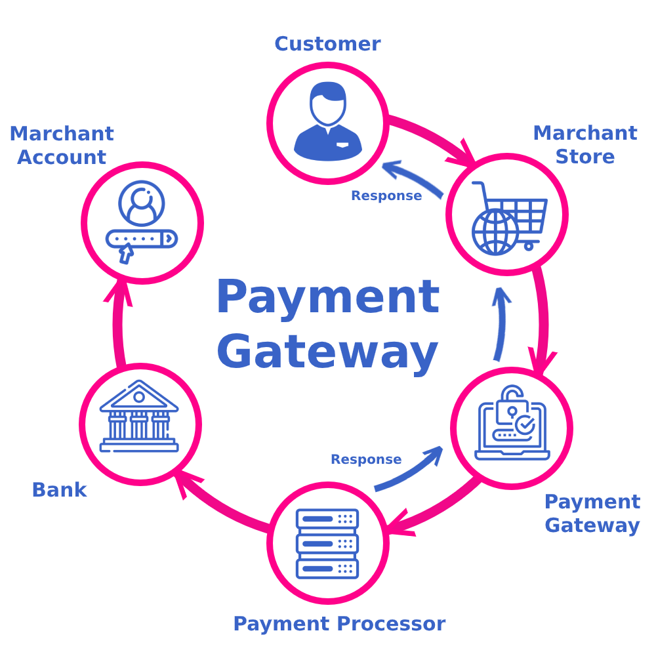
Payment Module
Definition
Payment gateway is a service that authorizes and processes debit/credit or paypal payments for online food application.

Slide 8
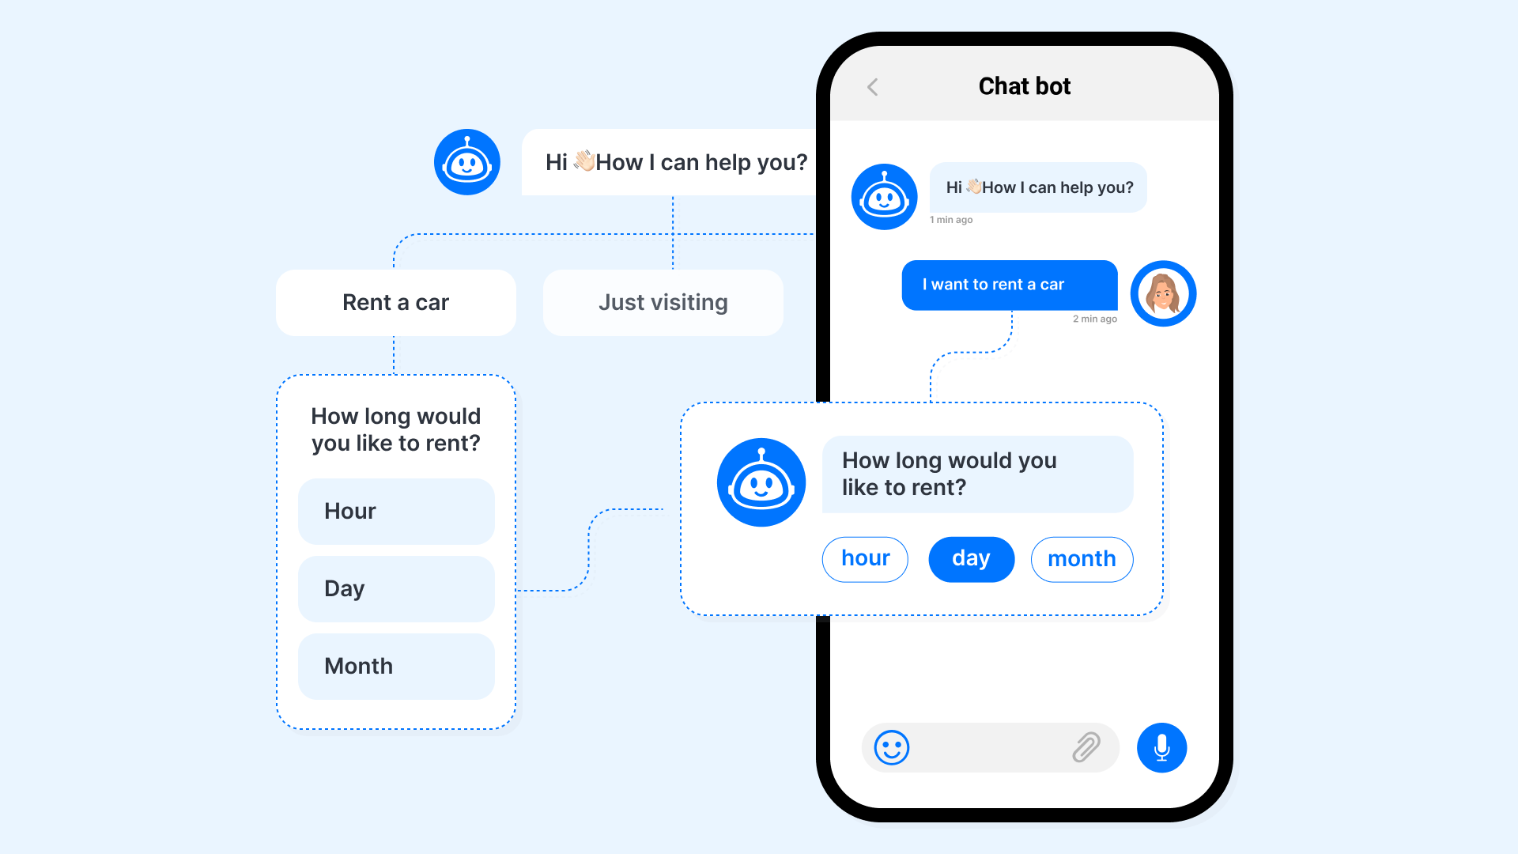
Chat Bot
Definition
At the most basic level, a chatbot is a computer program that simulates and processes human conversation (either written or spoken), allowing humans to interact with digital devices as if they were communicating with a real person.

Slide 9
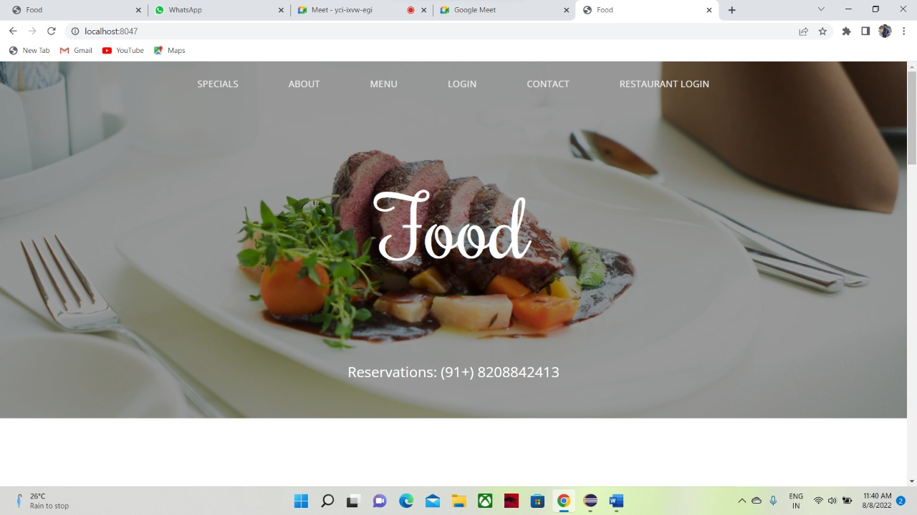
Front End Design
Food application Front end design :
Using HTML, CSS, JS designed a front end page for customer module where it can display all the necessary food items and price and details for contact.

Slide 10
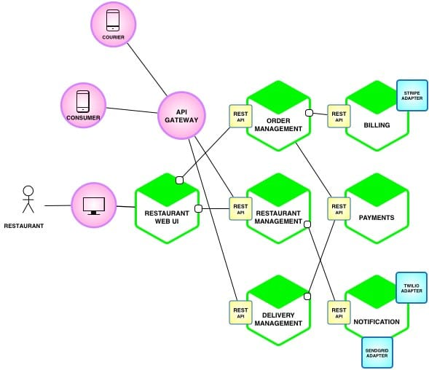
Project Overview
Project Architecture Diagram

Slide 11
Tech Architecture Diagram

